Slide 1



Gennadii Mishchevskii, Ciklum, Ukraine
JavaScript Understanding Asynchronism

Slide 2

whoami
Gennadii Mishchevskii
Senior Automation QA Engineer at Ciklum
4 years in the industry
Automated back-end, front-end and mobile
https://www.linkedin.com/in/gennadiimishchevskii/

Slide 3

Agenda
Async theory
Callback
Promises
Async/Await
Quiz

Slide 4
Warm-up
typeof null;
null > 0;
object
false
typeof NaN;
null == 0;
number
false
let wtf = () => { try { return 24; } finally { return 42; } }; wtf();
NaN instanceof Number;
null >= 0;
true
false
typeof 'string';
{} + [];
string
0
'string' instanceof String;
true + true - false > true ** 2;
false
true
'1' + +'1';
‘11’
42
'1' - -'1';
2

Slide 5



Async theory
Order food
Pay
Clean after yourself

Slide 6
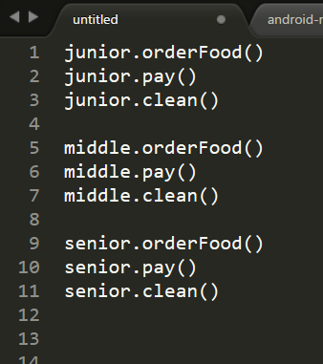
Async theory - PHP server, Single Sync thread

Slide 7
Async theory - PHP server, Single Sync thread
timeline
Order food
Pay
Clean after yourself

Slide 8
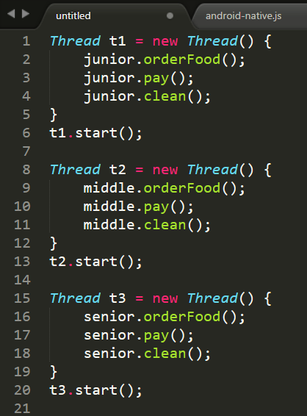
Async theory - Multithreading Java server

Slide 9
Async theory - Multithreading Java server
timeline
Main thread
Thread 1
Thread 2
Thread 3
Order food
Pay
Clean after yourself

Slide 10
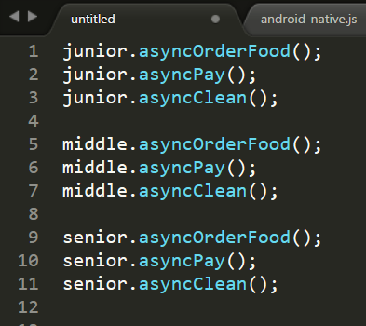
Async theory - NodeJS Async server

Slide 11
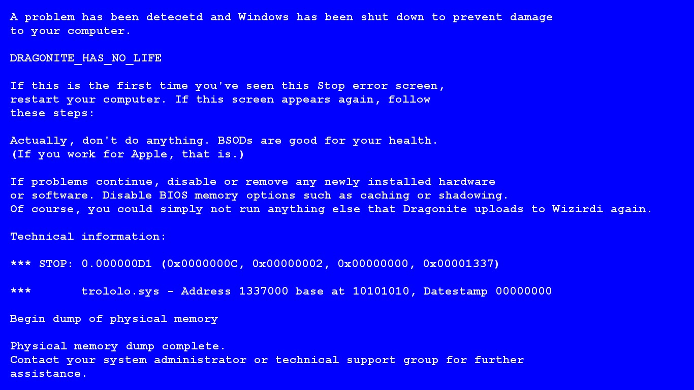
Async theory - NodeJS Async server
Libuv
timeline
Single thread
Order food
Pay
Clean after yourself
// example1.js

Slide 12
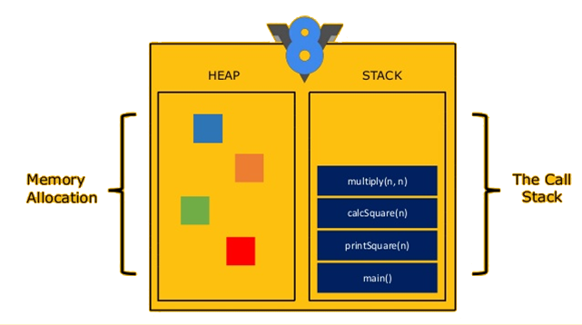
Async theory - Stack and heap
// stack.js, stackTrace.js, maxCallStack.js

Slide 13
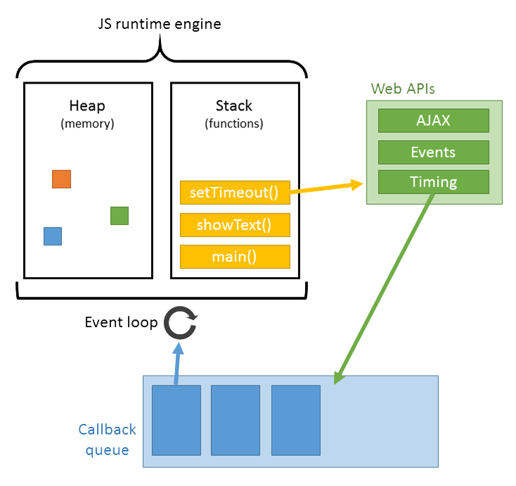
Async theory - Full picture
// fullPicture.js

Slide 14
Promises - 99.99% can't solve this task
const func1 = () => Promise.resolve(1);
const func2 = num => num === 1 ? 2 : 0;
func1().then(function () { return func2(); }); func1().then(function () { func2(); }); func1().then(func2()); func1().then(func2);

Slide 15
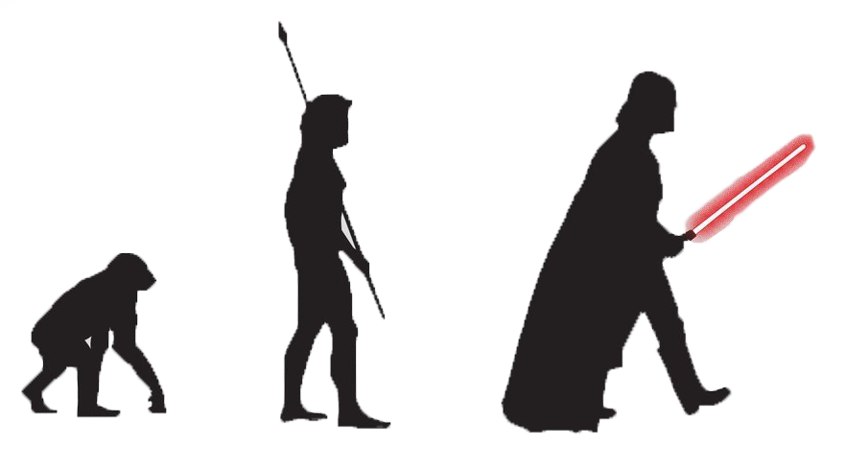
Promises - evolution
Promise
Async/Await
Callback

Slide 16
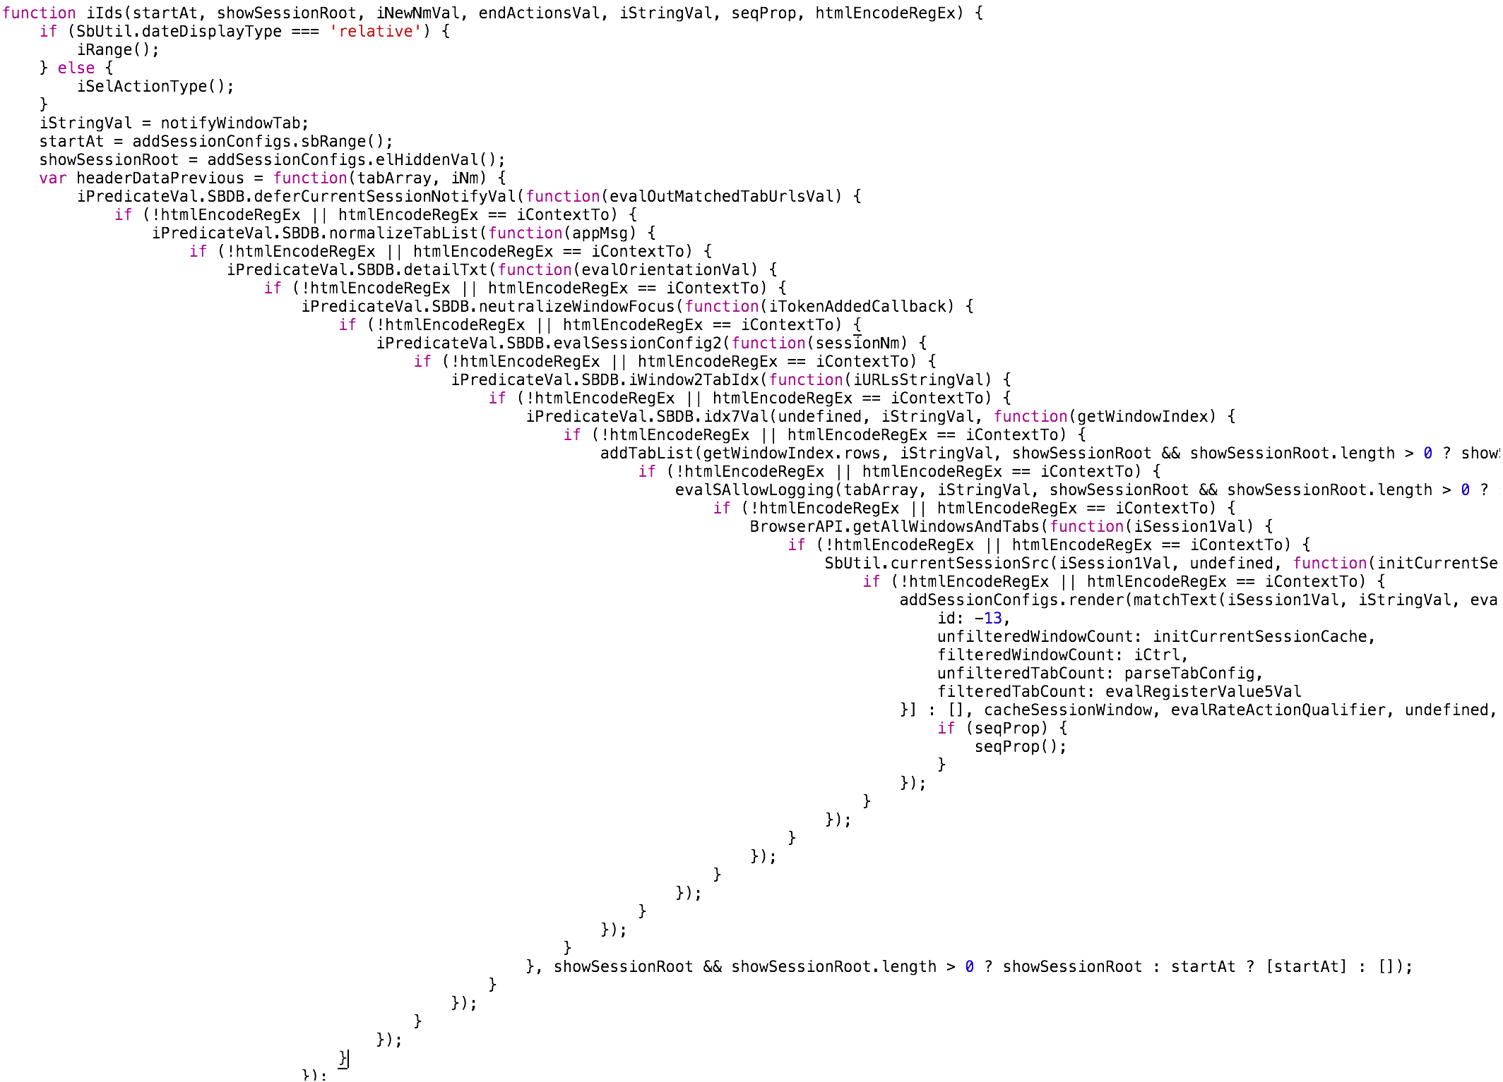
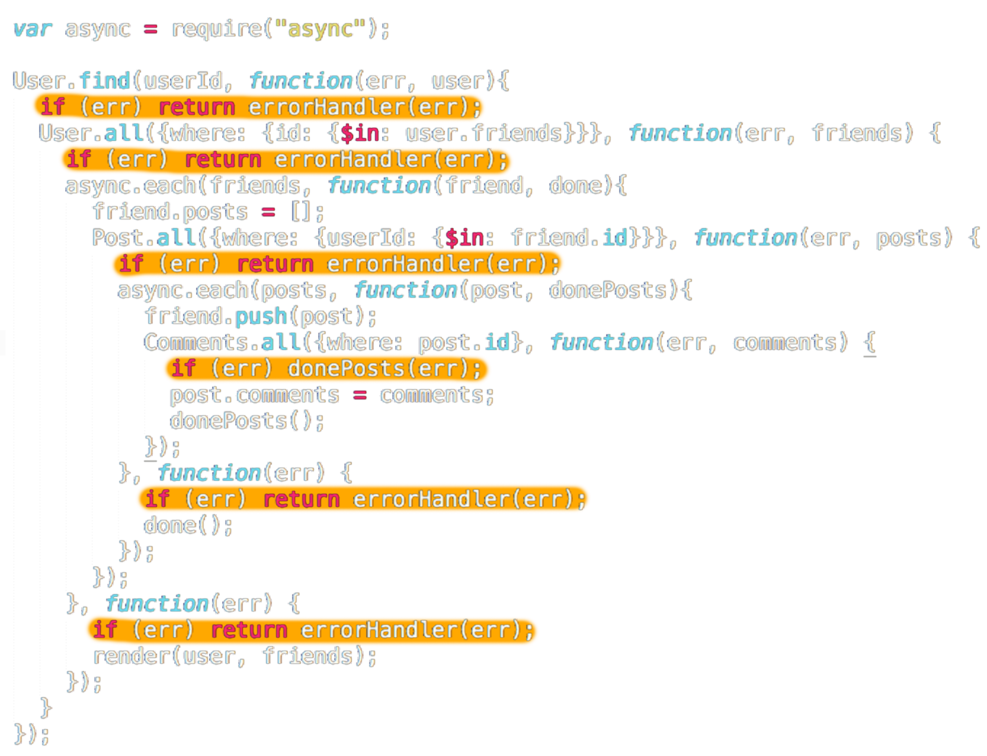
Callback – why don't we love callbacks
Callback hell
Catching errors
Difficult to wait for several async actions to finish
// callbackLinux.js

Slide 17

Promises – the rescuer
Callback hell
Catching errors
Difficult to call async action 3 with results of async actions 1 and 2

Slide 18
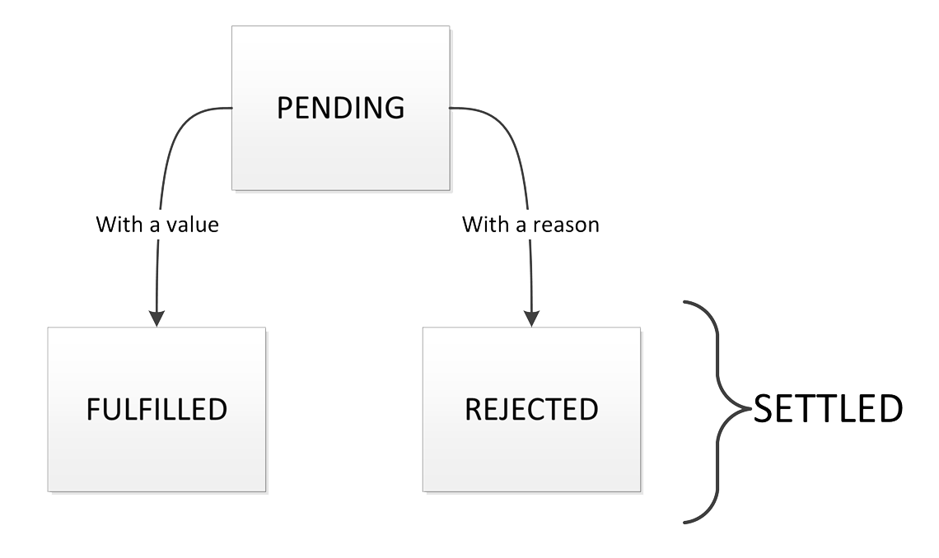
Promises – the rescuer (specs)
A promise or “thenable” is an object that supplies a standard-compliant .then() method.
A pending promise may transition into a fulfilled or rejected state.
Notes:
Promise или thenable – это объект, у которого есть метод then
У промиса есть 3 состояние – Pending, Fulfilled и Rejected

Slide 19
Promises – the rescuer (specs)
A fulfilled or rejected promise is settled, and must not transition into any other state.
Once a promise is settled, it must have a value (which may be undefined). That value must not change.
Every promise must supply a .then() method with the following signature:
promise.then( onFulfilled?: Function, onRejected?: Function ) => Promise
Notes:
Fulfilled или rejected promise - это settled promise и он более не может менять своего состояния.
Когда промис переходит в settled состояние у него должно быть валью (валью может быть undefined). И это валью поменяться не может
У каждого промиса должен быть then метод со следующим синтаксисом

Slide 20
Promises – the rescuer (specs)
Both onFulfilled() and onRejected() are optional.​
If the arguments supplied are not functions, they must be ignored.​
onFulfilled() will be called after the promise is fulfilled, with the promise’s value as the first argument.​
onRejected() will be called after the promise is rejected, with the reason for rejection as the first argument. The reason may be any valid JavaScript value, but because rejections are essentially synonymous with exceptions, I recommend using Error objects.​
Notes:
Оба колбека на resolve и на reject – опциональные
Если аргументы thena – не функции – они игнорятся
Онфулфил колбек должен быть вызван в случае резолва промиса и получить валью промиса первым аргументом
Онреджектед колбек должен быть вызван, когда промис переходит в состояние реджектед и должен получить причину ошибку первым аргументом. Зареджектить промис можно с любым валидным JS значением, но я рекомендую использовать объект Error

Slide 21
Promises – the rescuer (specs)
.then() may be called many times on the same promise. ​
.then() must return a new promise, promise2.​
If either onFulfilled or onRejected throws an exception e, promise2 must be rejected with e as the reason.​
If onFulfilled is not a function and promise1 is fulfilled, promise2 must be fulfilled with the same value as promise1.​
If onRejected is not a function and promise1 is rejected, promise2 must be rejected with the same reason as promise1.​
Notes:
Then можно вызывать много раз на 1 промис
Then должен возвращать новый промис
Когда промис 1 переходит в состояние реджектед, промис 2 должен быть зареджекшен автоматом с причиной ошибки из промиса 1
Если онфулфилд аргумент зена – не функция и промис 1 зарезолвлен, то промис 2 должен быть рарезолвлен автоматом со значением промиса 1
То же самое происходит с реджектом

Slide 22
Promises – the rescuer (create and chain)
function myRandomPromise() { return new Promise(function (resolve, reject) { const random = Math.random(); random < 0.5 ? resolve('Yay, it worked') : reject('Oh no, something went wrong'); }) }
myRandomPromise() .then(result => console.log(result), error => console.log(error));
myRandomPromise() .then(console.log, console.log);
myRandomPromise() .then(console.log) .catch(console.log);
myRandomPromise() .catch(console.log);
myRandomPromise() .then(null, console.log);
Notes:
Пример создания и чейна промиса

Slide 23
Promises – the rescuer (don't forget to catch)
Promise.resolve(42) .then(doFirst) .then(doSecond) .catch(console.log) .then(doThird) .catch(err => { console.log(err); return err.message; }) .then(doFourth) .catch(console.log);
Notes:
Очень важно не забывать catch. Писать его можно в любом месте, т.к. он тоже возвращает промис.

Slide 24
Promises – the rescuer
(what’s gonna happen?)
function myPromise() { return new Promise(resolve => { Object.notExistingFunction(); resolve('Resolved'); }) } myPromise() .then(console.log) .catch(console.log);
setTimeout(_ => console.log('setTimeout'));
Notes:
Что должно произойти?

Slide 25
Promises – the rescuer
(how to ruin it)
function myRandomPromise(num) { return new Promise(function (resolve) { resolve(Math.random()); }); }
myRandomPromise().then(num => { return myRandomPromise().then(num => { return myRandomPromise().then(num => { return myRandomPromise().then(num => { return myRandomPromise().then(num => { return myRandomPromise().then(num => { console.log(num); }); }); }); }); }); });
myRandomPromise() .then(num => { return myRandomPromise() }) .then(num => { return myRandomPromise() }) .then(num => { console.log(num); });
// callbackedPromise.js
Notes:
Как можно внедрить callback hell в промисы

Slide 26
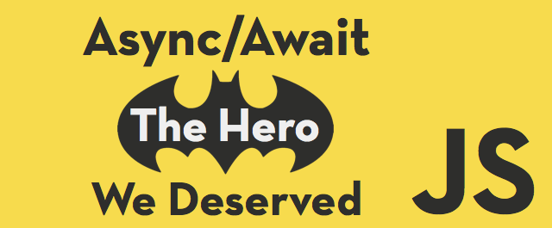
Async/Await – the advanced rescuer
Callback hell
Catching errors
Difficult to call async action 3 with results of async actions 1 and 2
// promiseLunix.js (…rest)
Notes:
Async Await – это синтаксический сахар для промисов.
Работают они только с промисами.
Async await даёт возможность работать синхронно с асинхронным кодом внутри асинхронной функции.

Slide 27
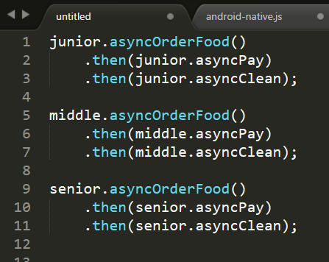
Async theory - NodeJS Async server

Slide 28
Async theory - NodeJS Async server
Libuv
timeline
Single thread
Order food
Pay
Clean after yourself
// example2.js

Slide 29
Quiz – 1. What will be the result
let prоm = new Promise((resolve, reject) => { resolve('Some message'); }); prоm .then((result) => { console.log(result); }, (err) => { console.log('Errоr оccurred'); });
Some message
Errоr оccurred
Nothing
Some message Errоr оccurred
Errоr оccurred Some message

Slide 30
Quiz – 2. What will be the result
let prоm = new Promise((resolve, reject) => { reject('Some message'); }); prоm .then((result) => { console.log(result); }, (err) => { console.log('Errоr оccurred: ' + err); });
Some message
Error occurred:
Error occurred: Some message
Some message Error occurred:
Nothing

Slide 31
Quiz – 3. What will be the result
let prоm = new Promise((resolve, reject) => { reject('Some message'); }); prоm .then((result) => { console.log(result); }) .catch(err => { console.log('Errоr оccurred: ' + err); });
Some message
Error occurred: undefined
Error occurred: Some message
Some message Error occurred:
Error will be thrown

Slide 32
Quiz – 4. What will be the result
let prоm = new Promise((resolve, reject) => { resolve('Some message'); }); prоm .then(result => { throw new Error(result); }, err => { console.log('Error occurred: ' + err) }) .catch((err) => { console.log('Error occurred inside: ' + err) });
Error occurred: Some message
Error occurred inside: Some message
Some message
Nothing
Error will be thrown

Slide 33
Quiz – 5. There's an element with locator
#myId. What will be the result
true true
false false
Error
true false
false true
console.log(element(by.css('#myId')).isPresent() === true); console.log(element(by.css('#myId')).isPresent() === false);

Slide 34
Quiz – 6. There's an element with locator
#myId and text inside 'some text'. What will be the result
Error
some text some text
some text Promise
some text undefined
getText getText
Promise Promise
element(by.css('#myId')) .getText() .then(value => { return element(by.css('#myId')).getText() .then(value2 => { console.log(value + ' ' + value2) }); });

Slide 35
Quiz – 7. There's an element with locator
#myId and text inside 'some text'. After click on element text changes to 'Clicked'. What will be the result
let elem = element(by.css('#myId')); let txt = elem.getText(); txt .then(txtBefore => { return elem.click() .then(_ => txt) .then(txtAfter => { console.log(txtBefore + ' ' + txtAfter); }); });
some text some text
some text Clicked
some text undefined
Error
txtBefore txtAfter

Slide 36
Quiz – 8. There's an element with locator
#myId and text inside 'some text'. After click on element text changes to 'Clicked'. What will be the result
some text some text
some text Clicked
some text undefined
Error
txtBefore txtAfter
let elem = element(by.css('#myId')); elem .getText() .then(txtBefore => { return elem.click() .then(_ => elem.getText()) .then(txtAfter => { console.log(txtBefore + ' ' + txtAfter); }); });

Slide 37
Quiz – 9. There's an element with locator
#myId and text inside 'some text'. After click on element text changes to 'Clicked'. What will be the result
some text some text
some text Clicked
txtBefore txtAfter
Promise Promise
let elem = element(by.css('#myId')); void async function logValues() { let txtBefore = await elem.getText(); await elem.click(); let txtAfter = await elem.getText(); console.log(txtBefore+ ' ' + txtAfter); }();

Slide 38
Quiz – 10. There's an element with locator
#myId and text inside 'some text'. After click on element text changes to 'Clicked'. What will be the result
let elem = element(by.css('#myId')); void async function logValues() { let txtBefore = elem.getText(); await elem.click(); let txtAfter = elem.getText(); console.log(txtBefore + ' ' + txtAfter); }();
some text some text
some text Clicked
txtBefore txtAfter
Promise Promise

Slide 39

Chat
https://goo.gl/2no6Zc

Slide 40

Repo
https://github.com/Gennadiii/testingStage18

Slide 41

We’ve done it!

